Slide 1
FitBit Use Case
RCChan5

Slide 2
The Use Case
Created a user friendly dashboard
Summarizes data regarding users activities and trends
Provides visual representations, allowing users to easily identify where they stand among the larger population of other healthy individuals
Uses unsupervised machine learning and dimension reduction to try to identify features using K-means clustering.
Link to front end Streamlit App:
https://rcchan5-fitbit-user-streamlit-fitbit-4o2xmi.streamlit.app/
Help determine whether an individual is healthy or not based on 4 parameters
Number of steps taken each day
Distance walked
Number of calories burned
Hours of sleep one receives

Slide 3
Business Rules
A user can only have 1 address and 1 address may only have one user connected to it
Each daily activity can have one to many UserInfo
Each daily activity can have one to many active times
Each daily activity can have one to many active distances
Each daily activity can have one to many sleep times

Slide 4
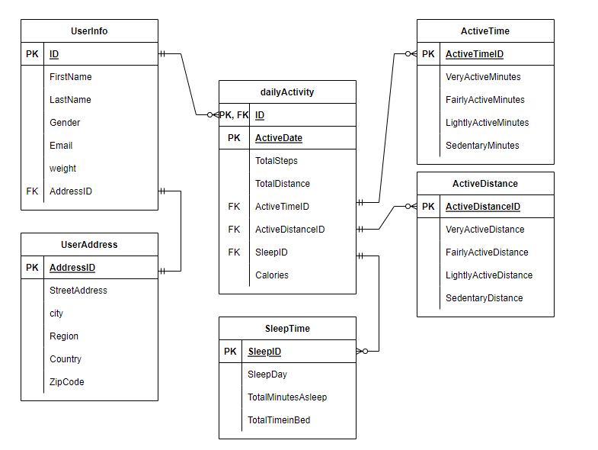
ERD Diagram

Slide 5
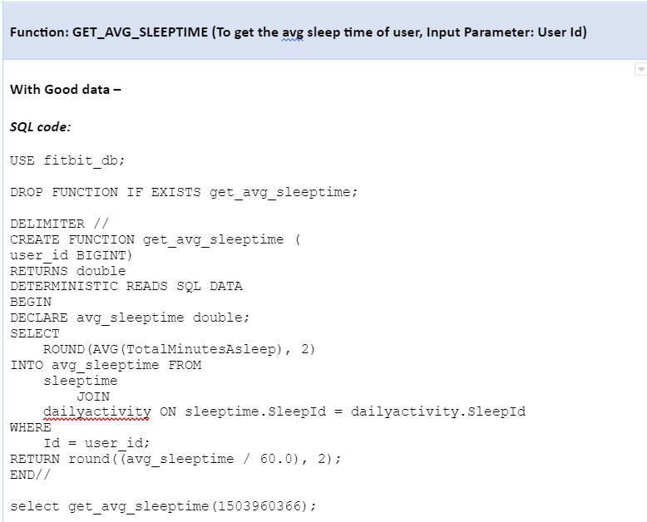
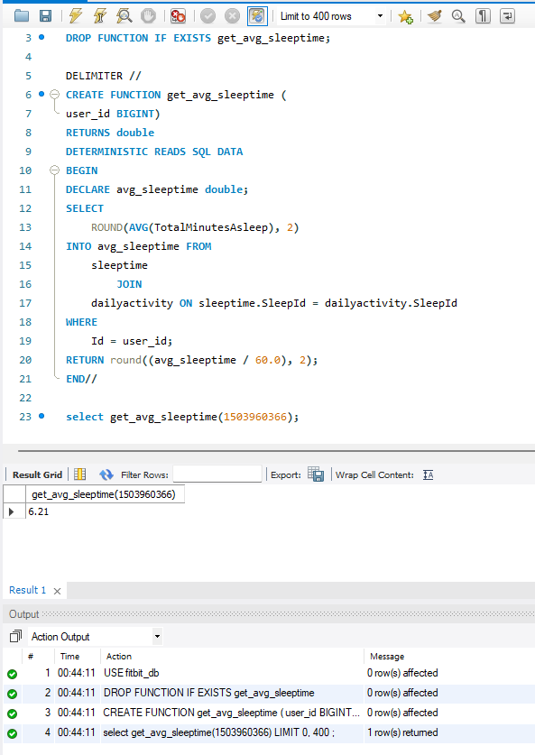
Function Query

Slide 6
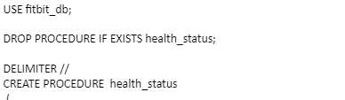
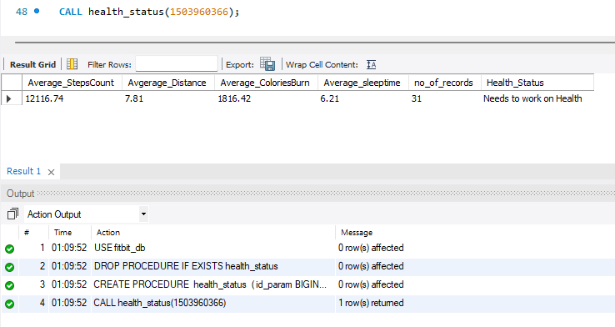
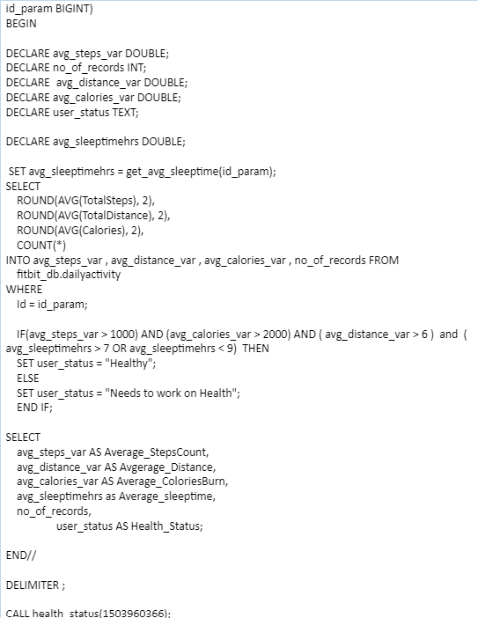
Stored Procedure

Slide 7
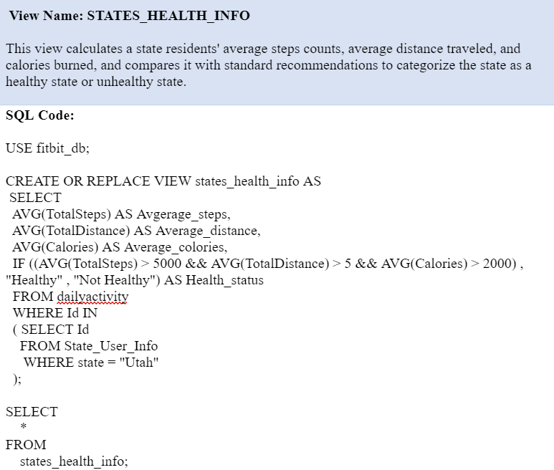
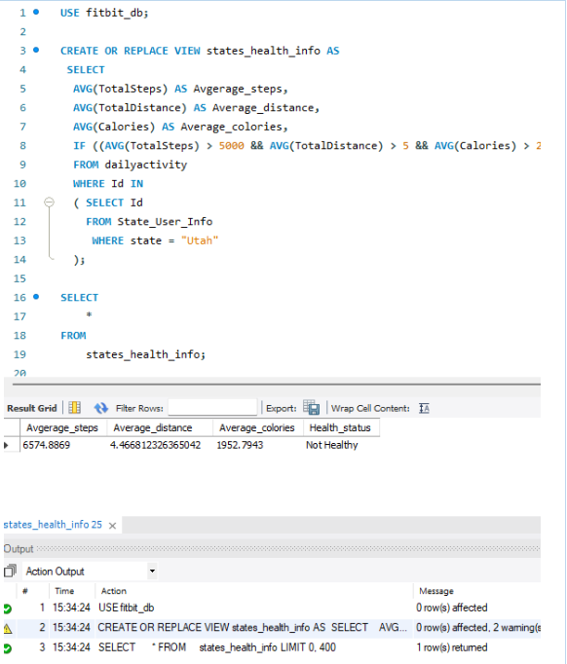
Advanced Views

Slide 8
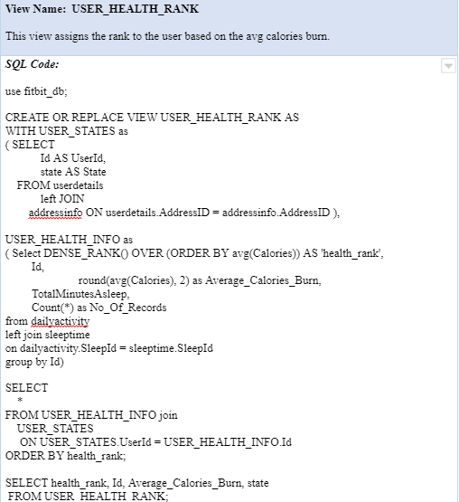
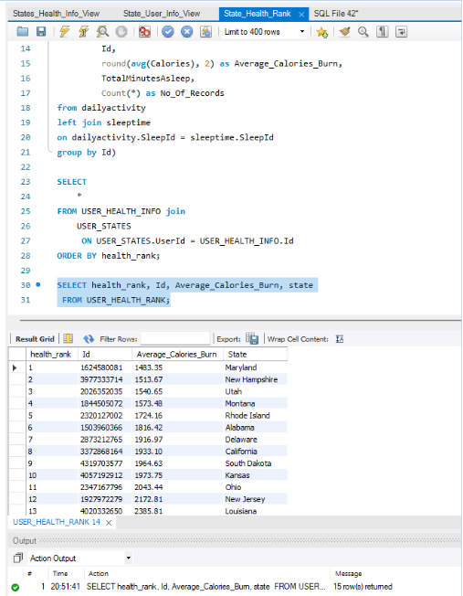
Advanced Views Cont’d

Slide 9
Relevance of Queries to Use Case
Function Query:
This query allows us to calculate the average hours of sleep an individual receives which then can be imputed into our stored procedure
Stored Procedure Query:
By returning average steps taken in a day, number of calories burned, and hours of sleep received, this query is able to provide us with the health status of a certain individual in which we are able to identify whether they are healthy or not
Advanced Views:
States_Health_Info calculates a state’s residents average distance traveled, calories burned, and compares it against our 4 parameter to determine whether the state as a whole is healthy or not
User_Health_Rank is used to rank the users healthiness based on the average amount of calories burned

Slide 10
Reference
Link to dataset:
Fitbit Dataset

